Slide 1


Unlock the Secrets to Effective Lesson Planning
Rob Jenkins | Santa Ana College
Brazil 2014

Slide 2
Lesson Planning
“Good lesson planning is an often invisible but absolutely essential part of all good teaching - especially effective language teaching.”
(Hendrichsen)

Slide 3
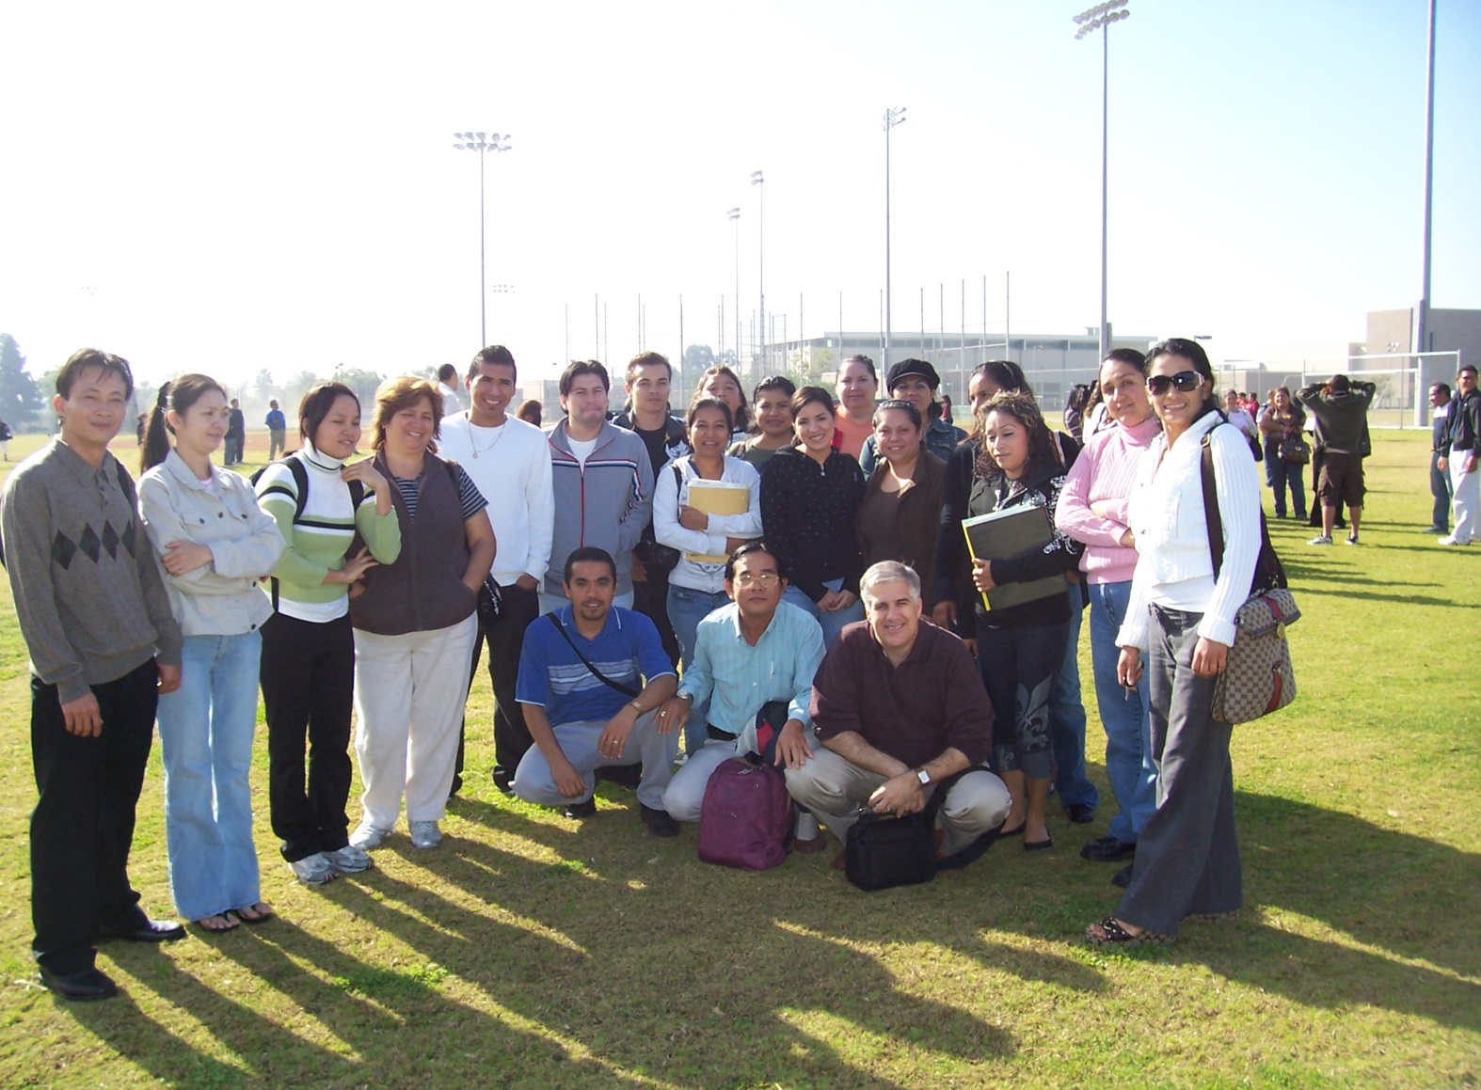

Why Plan?
Importance for Teacher
To focus activities toward an objective
To have seamless progression from one activity to the next
To evaluate student performance
To connect with preceding or subsequent lessons
Importance for Student
To gain confidence that activities have a purpose
To evaluate their own learning
To apply what they’ve learned
Notes:
May require more than one slide

Slide 4
MISSION STATEMENT
Give students
challenging opportunities
to be
successful
in their language-learning experience so they develop confidence and become independent, lifelong learners.

Slide 5
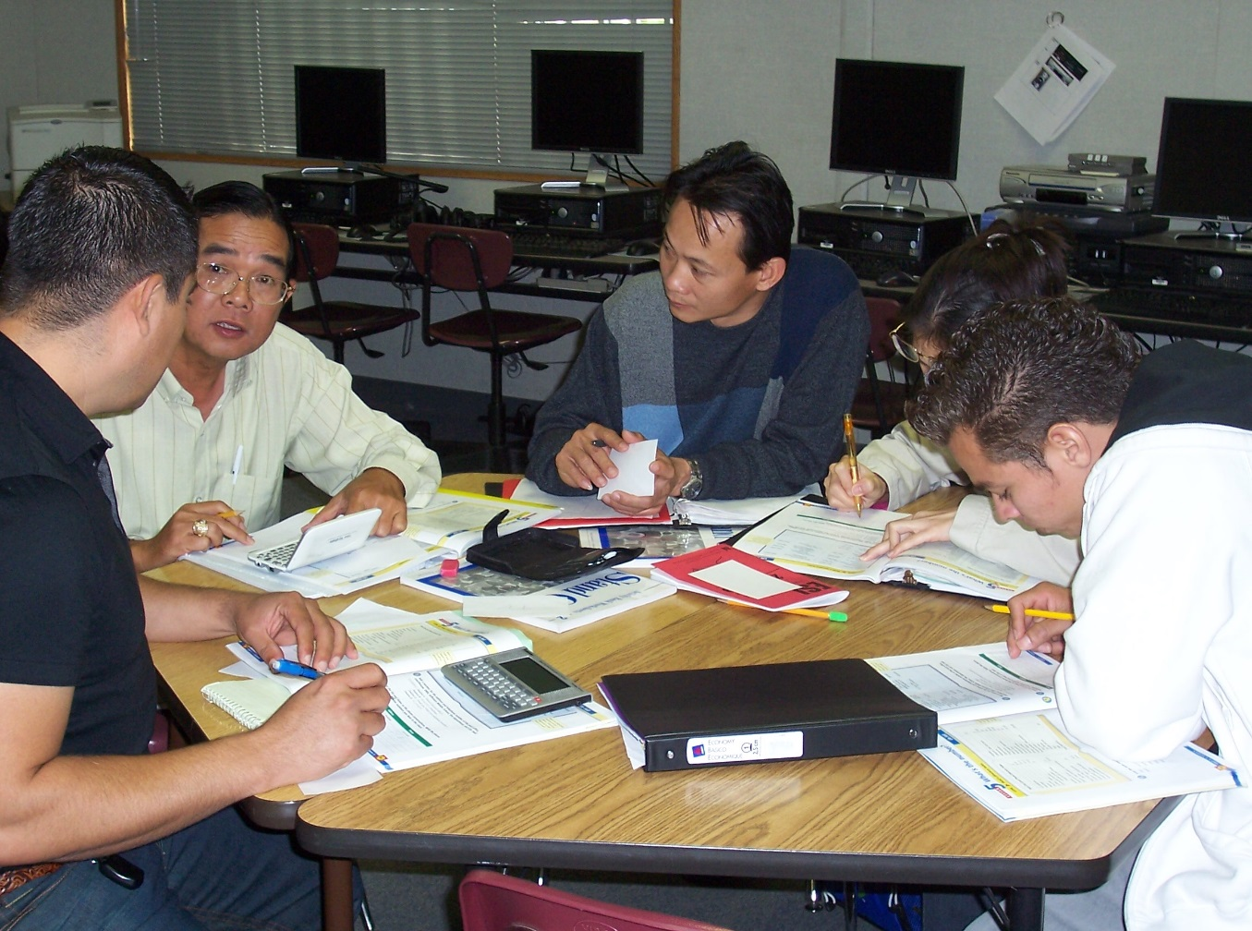
Challenging Opportunities
Teach students to:
    think critically
    work cooperatively
    transfer language and
    thinking skills to any task
Notes:
May require more than one slide

Slide 6
Steps to a Successful Lesson Plan
Put the following steps in the correct order.
      Application
      Introduction
      Warm-up / Review
      Practice
      Presentation
      Evaluation
Notes:
May require more than one slide

Slide 7

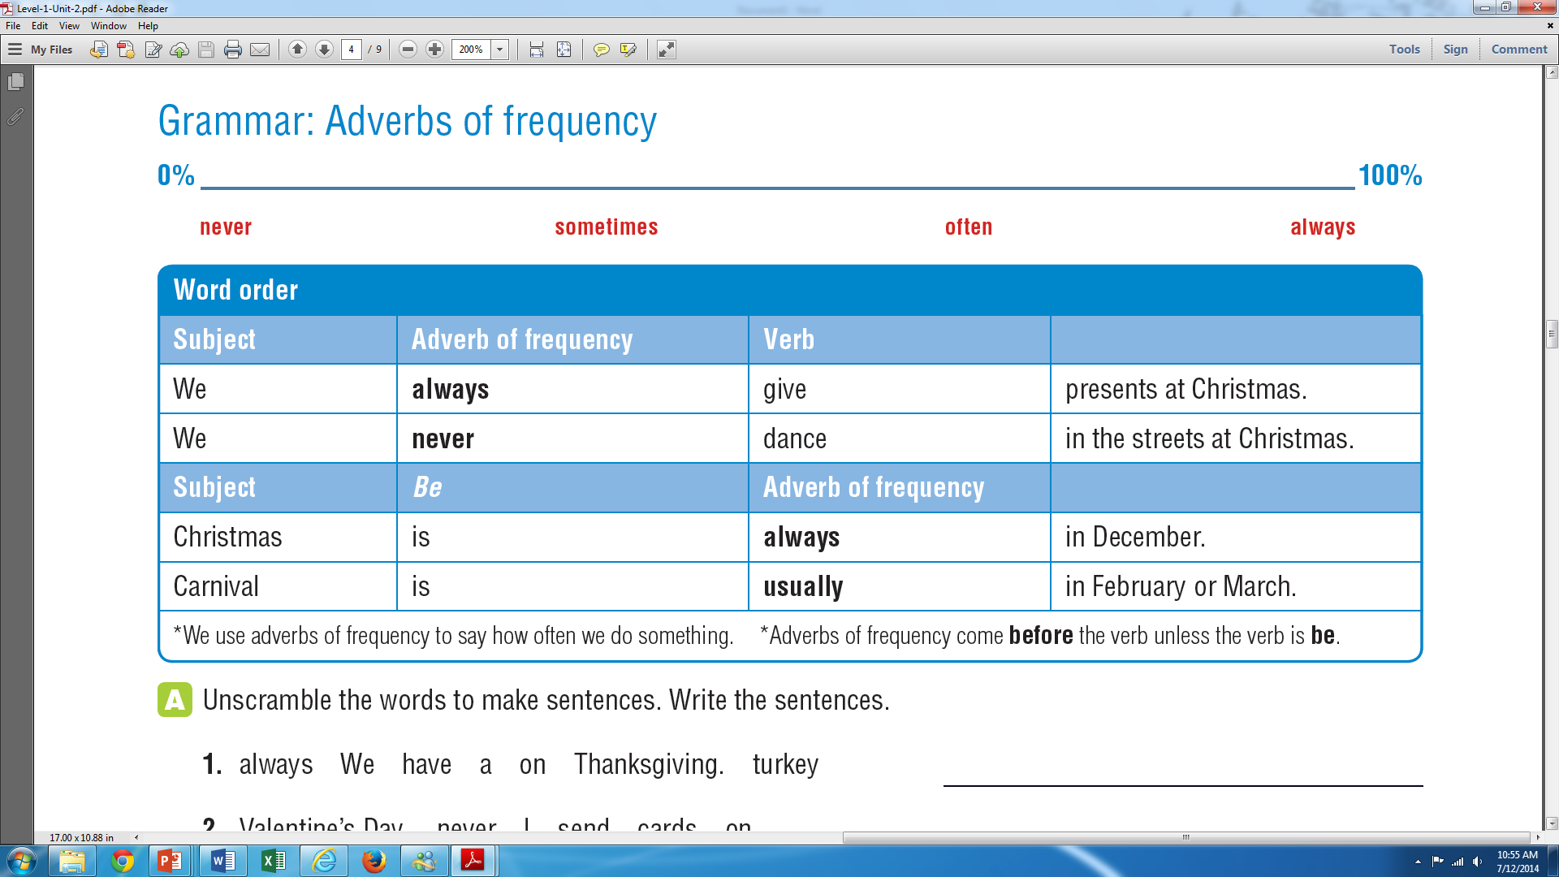
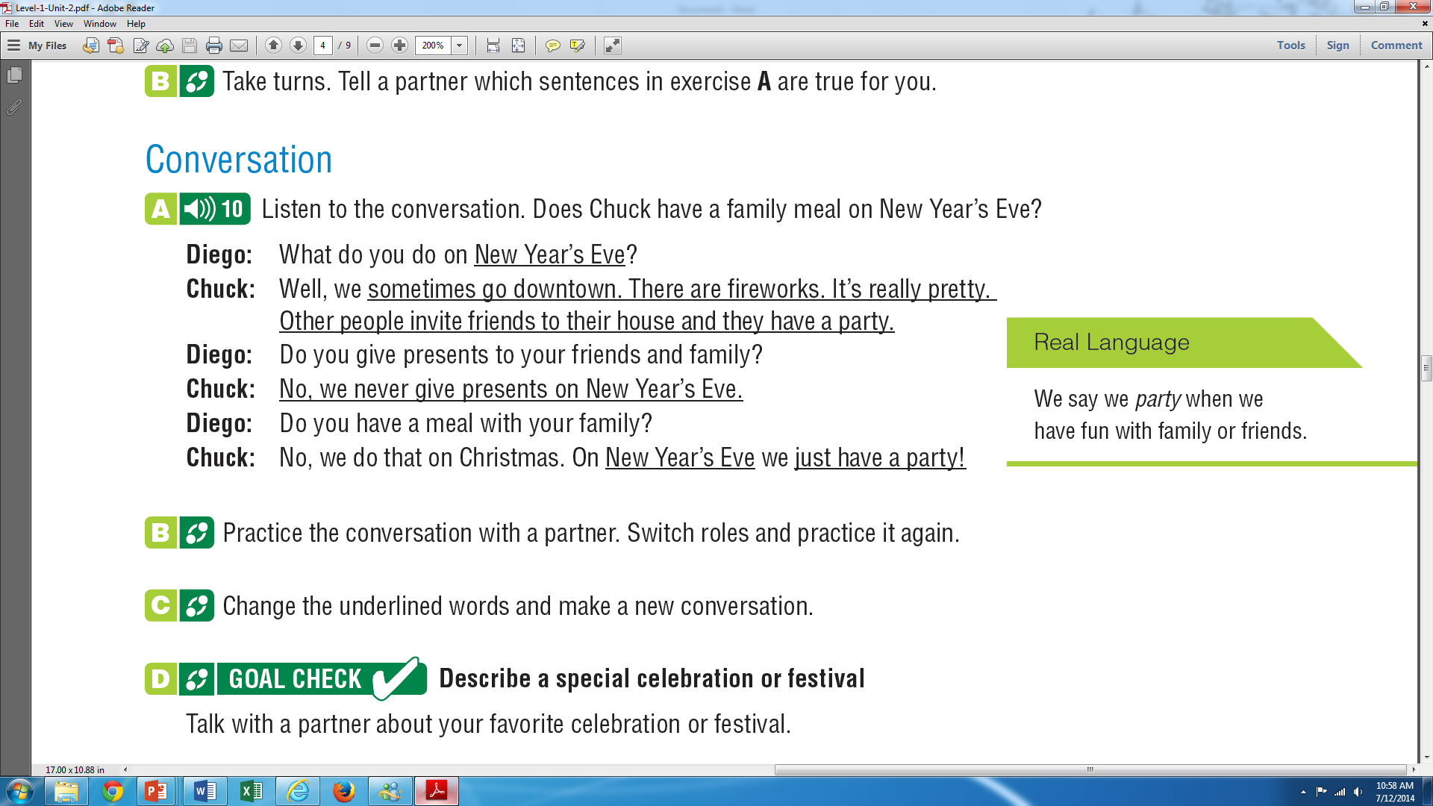
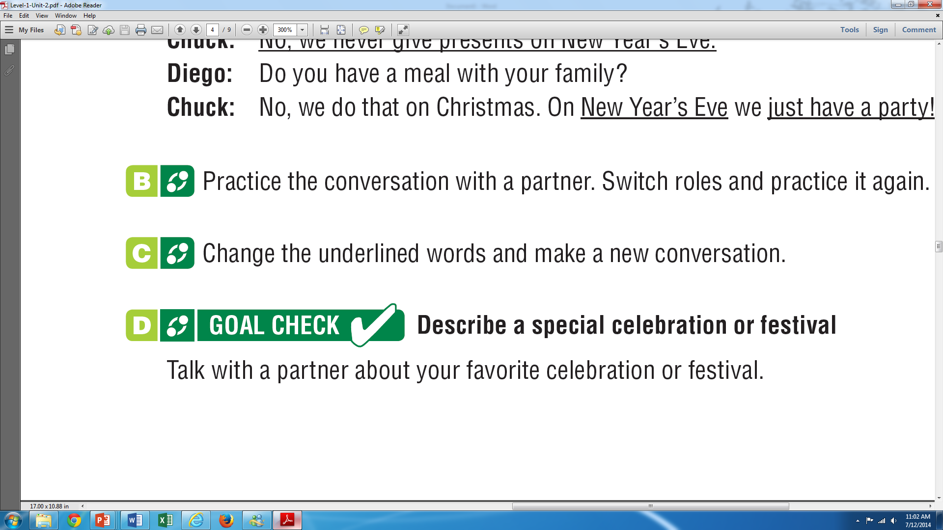
Ensure Success
Establish a context and purpose
⇒ Warm-up, Introduction
Provide students with the building blocks and skills they need
⇒ Presentation
Provide meaningful tasks
⇒ Practice
Ensure that students are successful
⇒ Evaluation
Allow students to use the language in a new real-life situation
⇒ Application
Notes:
May require more than one slide

Slide 8
What does it look like?

Slide 9
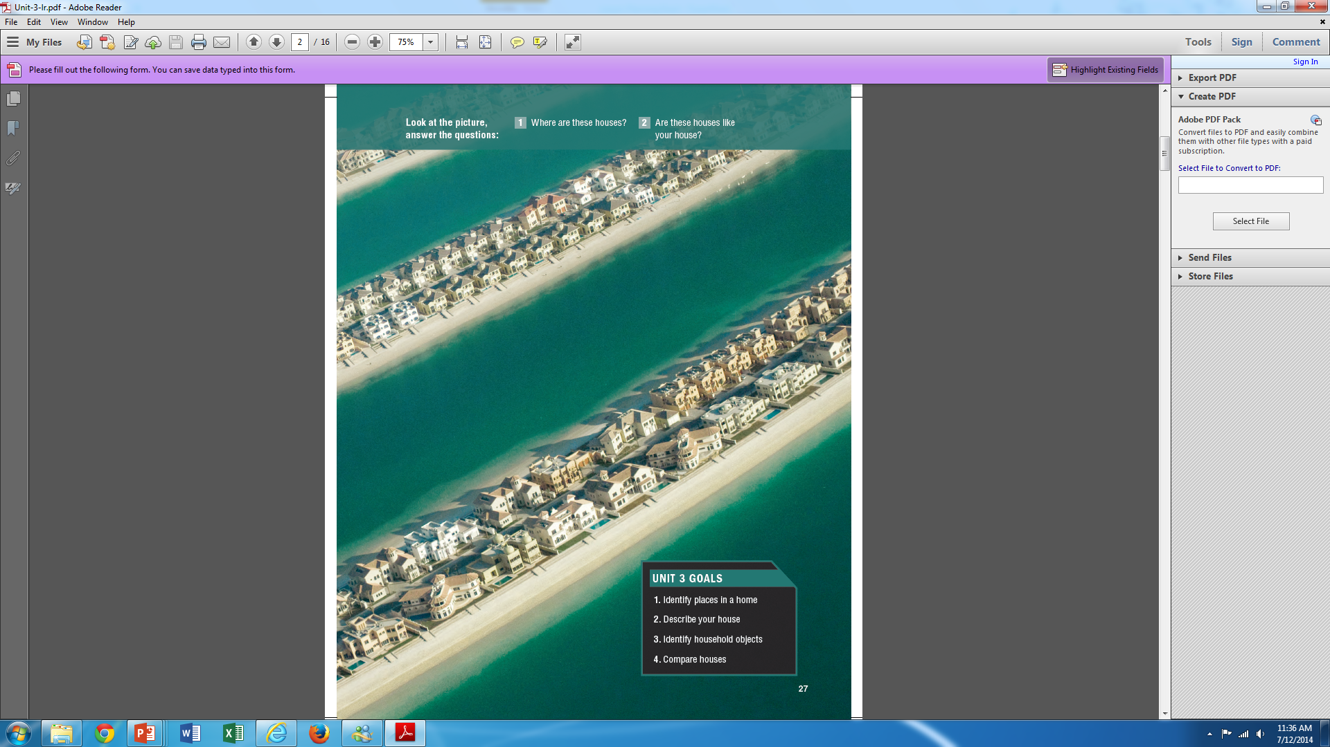
Introduction
Establish the Context
State the Objective
(by the end of class, students will be able to… )
By the end of class, students will be able to:
  Identify places in a home
  Describe their house
Identify household objects
Compare houses
Notes:
May require more than one slide

Slide 10
Introduction
Establish the Context
State the Objective
(by the end of class, students will be able to… )
By the end of class, students will be able to:
  Identify places in a home
  Describe their house
Identify household objects
Compare houses
Notes:
May require more than one slide

Slide 11
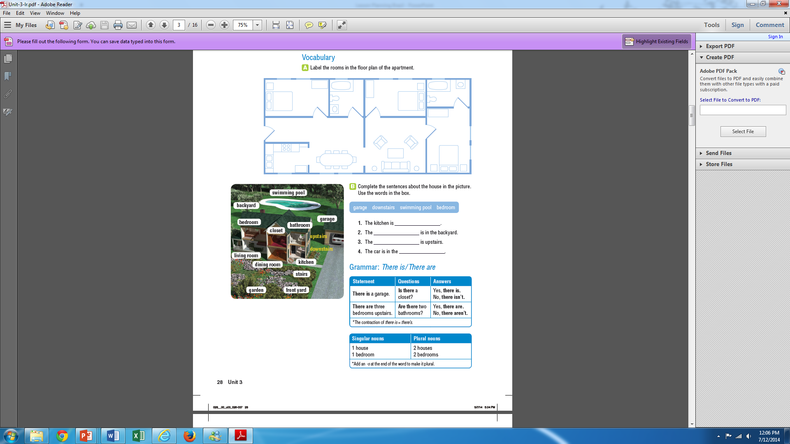
Presentation
Identify what students already know by asking questions, stories…
Present new information through visuals, stories….
Prepare for practice
Teaching TIP:
Elicit information from students
Objective:
Identify places in a home
Notes:
May require more than one slide

Slide 12
Presentation
Identify what students already know by asking questions, stories…
Present new information through visuals, stories….
Prepare for practice
Teaching TIP:
Elicit information from students
Objective:
Identify places in a home
Notes:
May require more than one slide

Slide 13
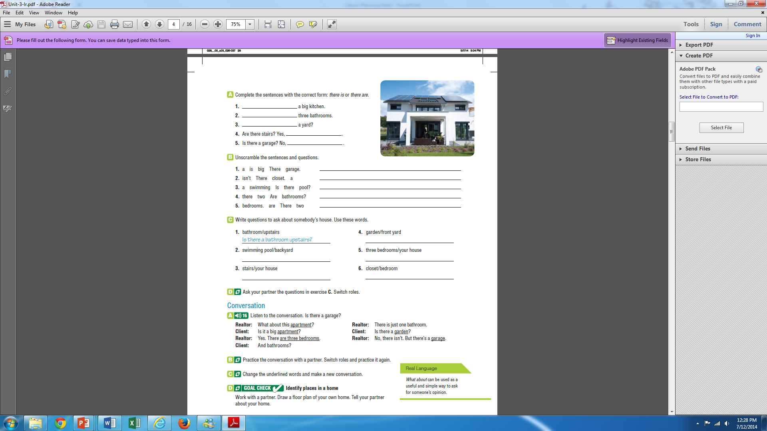
Practice / Evaluation
Help students be successful
Evaluate progress
Confirm they are ready for the application
mechanical
meaningful
Teaching TIP:
Scaffold from simple to complex and from mechanical to meaningful
Objective:
Identify places in a home
Notes:
May require more than one slide

Slide 14
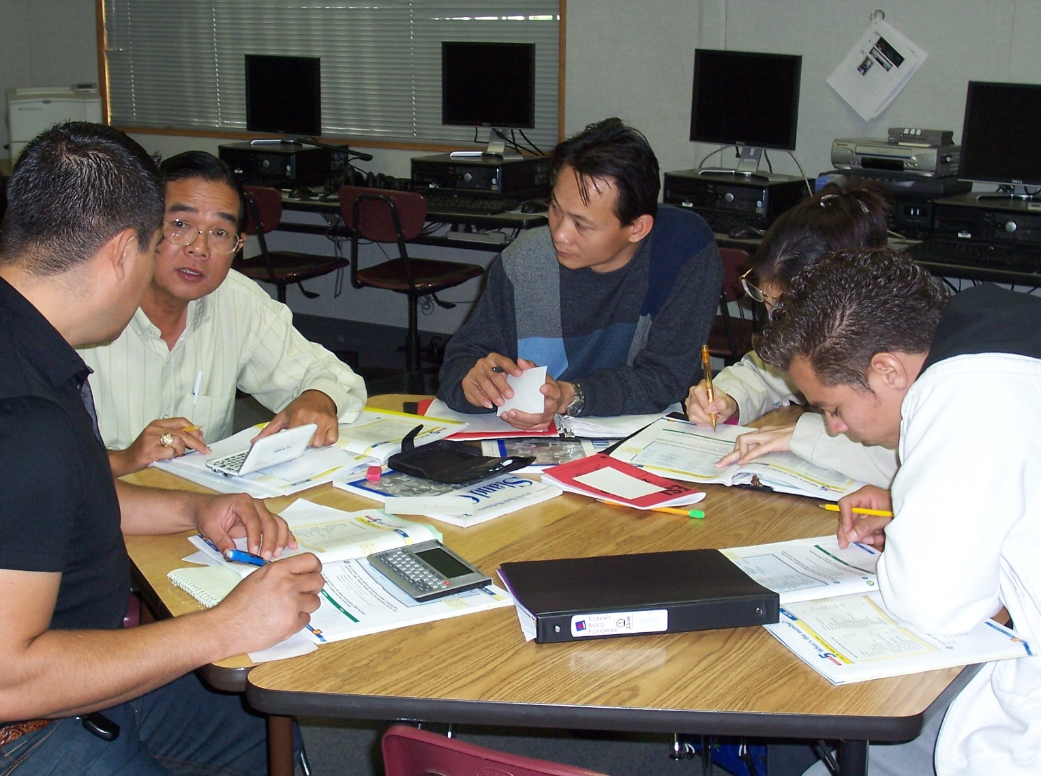
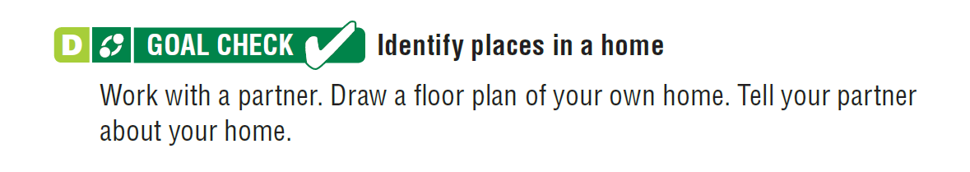
Application
Allow students to be creative
Provide opportunities to communicate
Make it real
Teaching TIP:
Based on the evaluation, if students are not ready for application, do more practice.
Notes:
May require more than one slide

Slide 15

Write your own
      Warm-up / Review
      Introduction
      Practice
      Presentation
      Evaluation
      Application
Notes:
May require more than one slide

Slide 16
THANK YOU!
Rob Jenkins Jenkins _rob@sac.edu
http://esl-teacher.net

